Slide 1


Code +

Slide 2
Today
Syntax
Variable
Datatypes
Code +

Slide 3
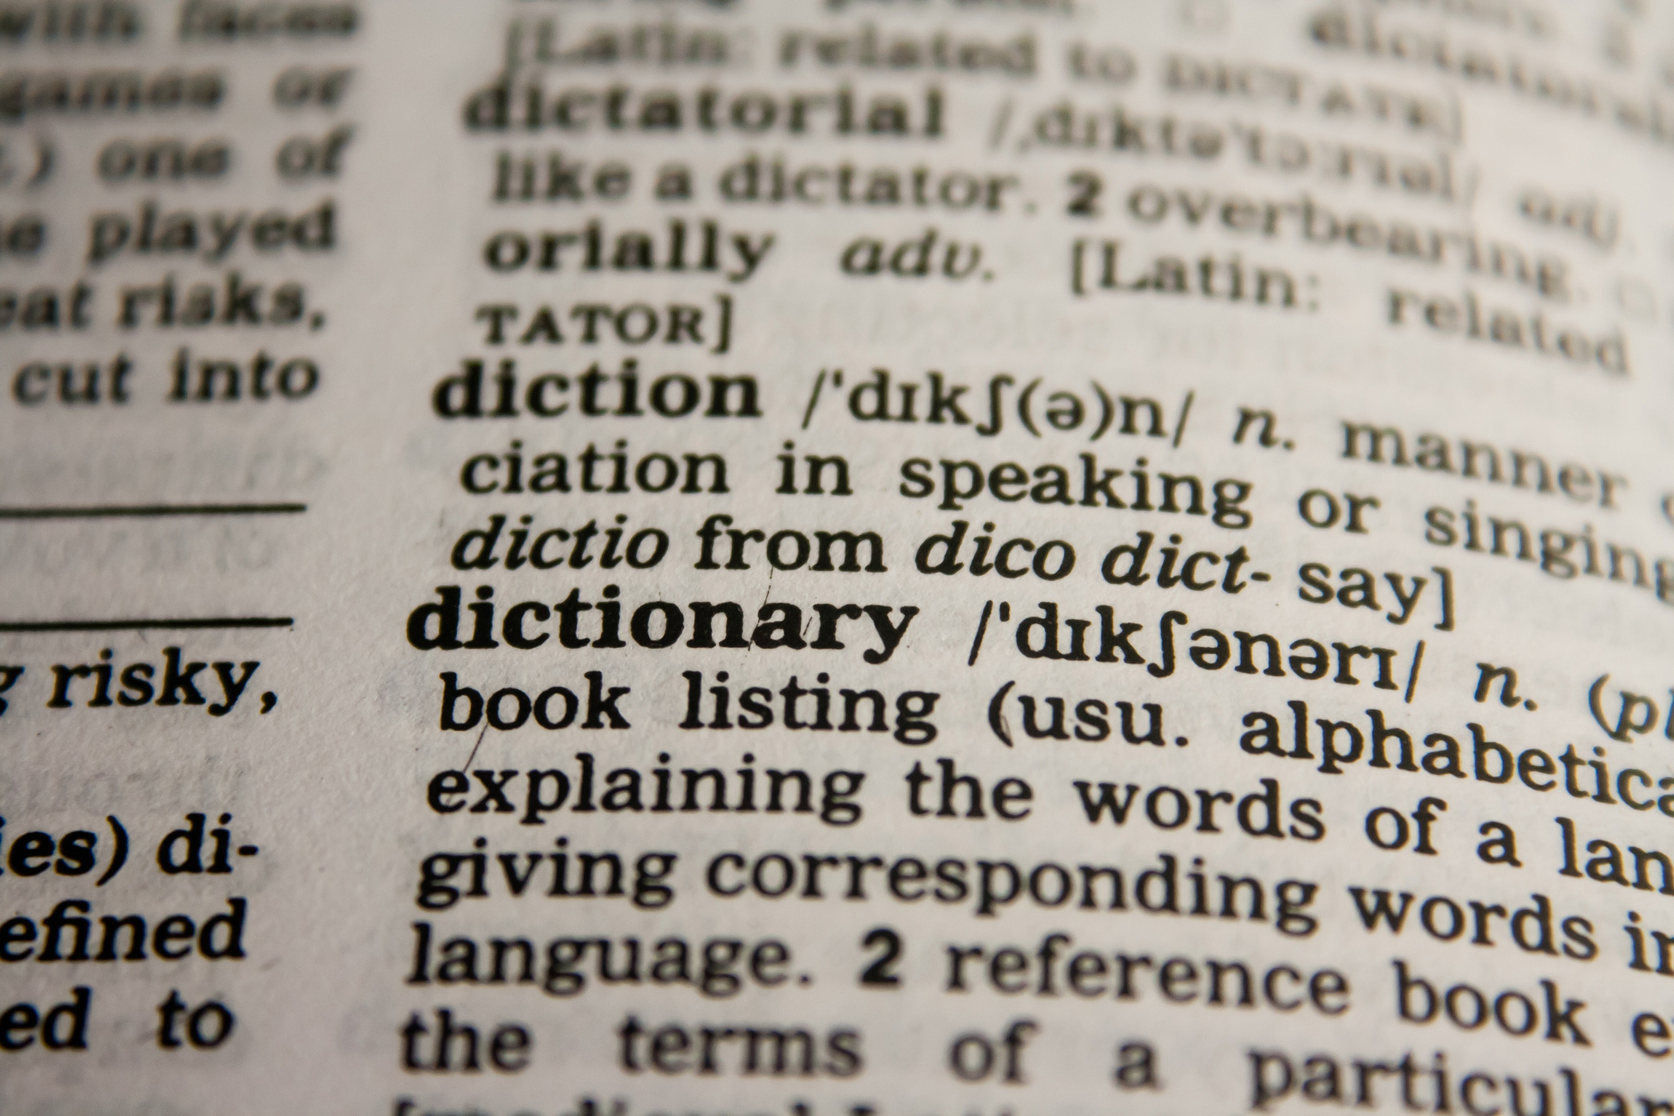
Syntax
import
def
“Jacob”
X = 3
print ()
for ()
class
elif
if
return
else
Code +

Slide 4
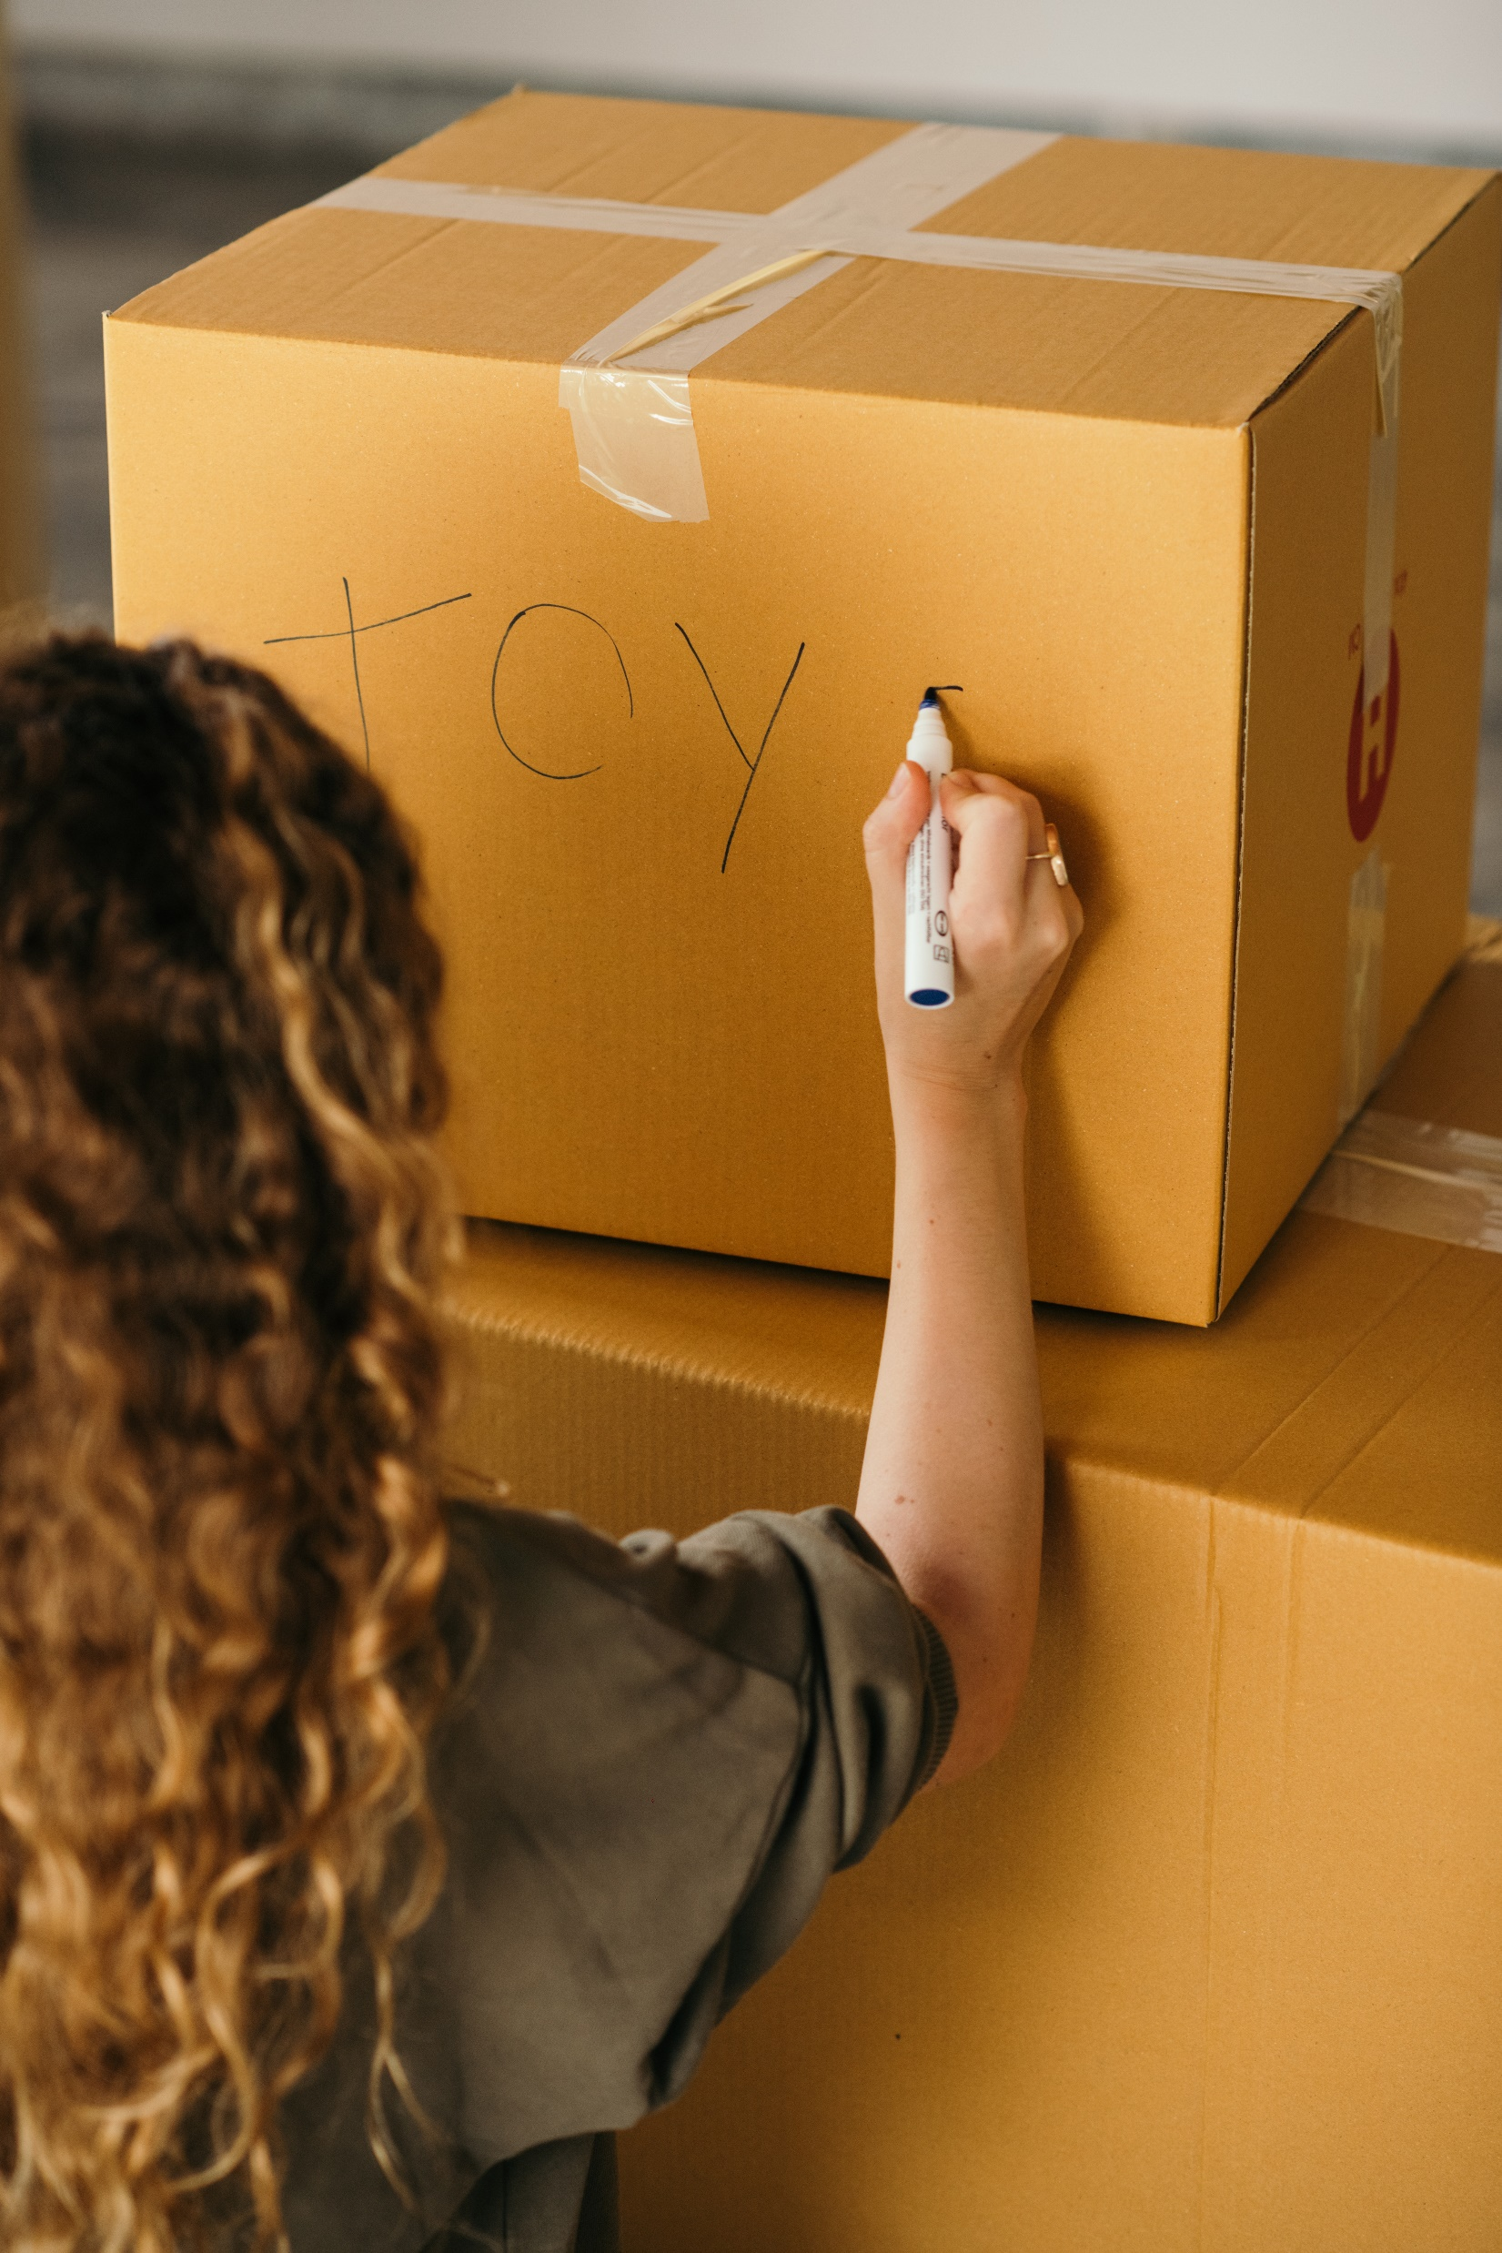
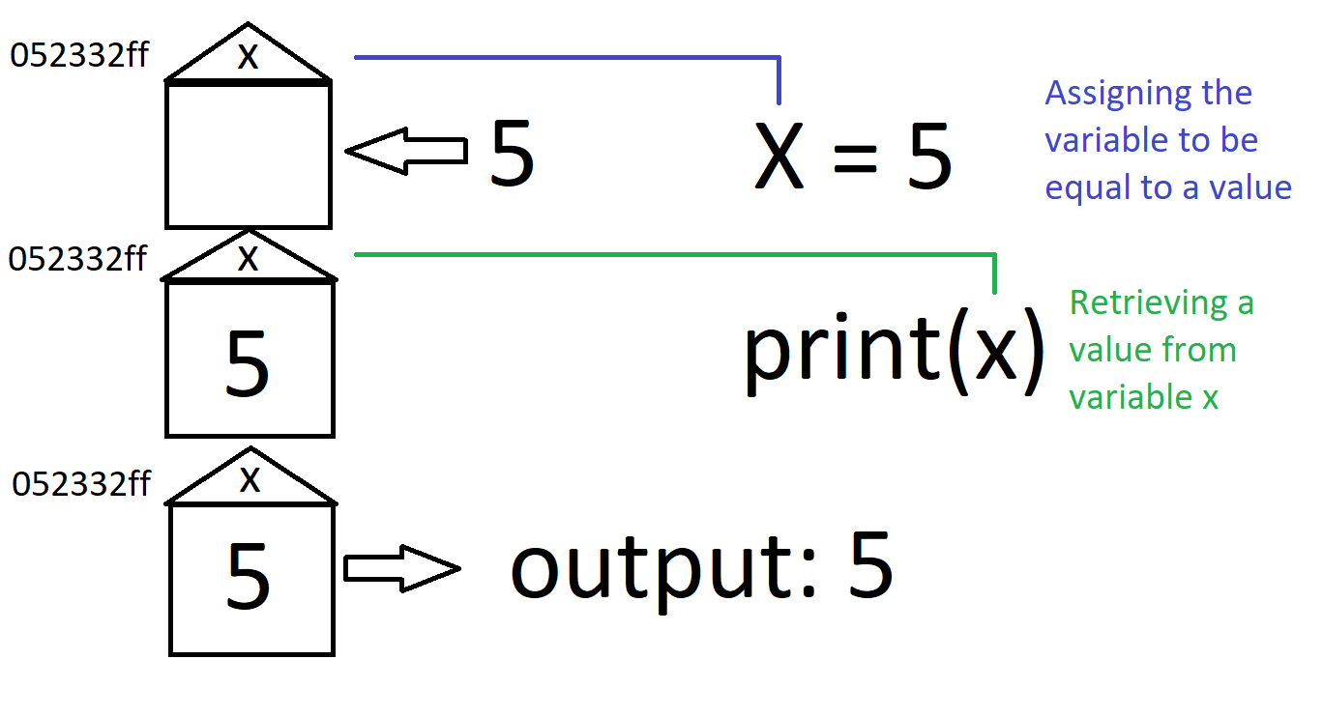
Variable
Code +

Slide 5
Data-types
Two words
What is data?
What types can you think of?
Code +

Slide 6
0
-1
1
integer
-1000
1000
9223372036854775807
Code +

Slide 7
“”
“James”
String
“Hello”
“Python is a high-level, general-purpose programming language. Its design philosophy emphasizes code readability with the use of significant indentation. Python is dynamically typed and garbage-collected.”
Code +

Slide 8
Code minute!
Task – use input command to allow user to input two number and then print the sum of those two numbers
Any problems?
Code +

Slide 9
False
boolean
True
Code +

Slide 10
-0.1
float
-13.15
0.11632
6937.394
Code +

Slide 11
Code minute!
Task –
Use your new knowledge to create a program which will ask the user to input their name as string, age as integer, weight as float and student as true or false
Tell them that in ten years they will be their age +10, probably 20 kg heavier and will no longer be a student if they are a student
Code +

